Slide 1
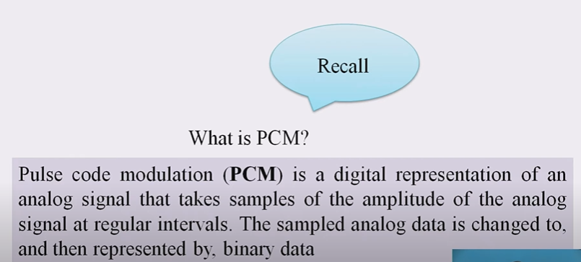

Slide 2
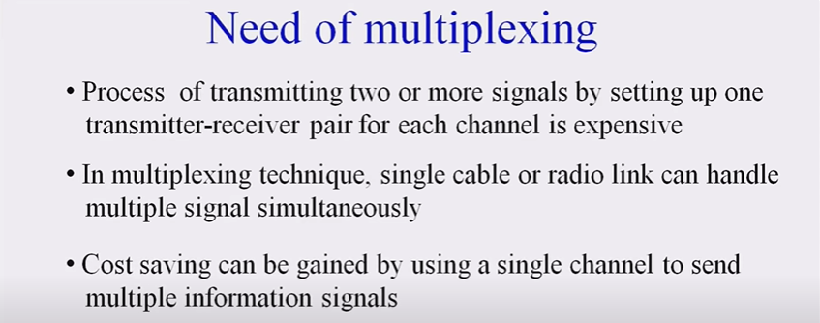

Slide 3
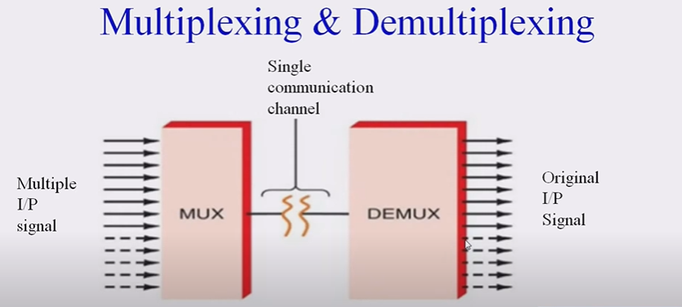

Slide 4
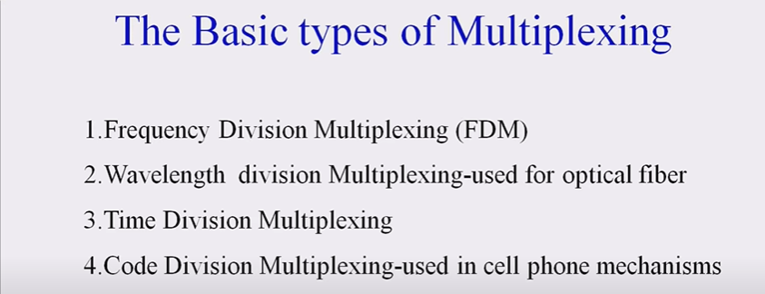

Slide 5


Slide 6
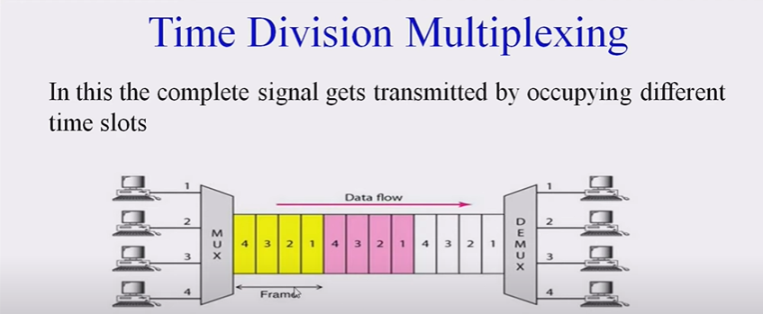

Slide 7
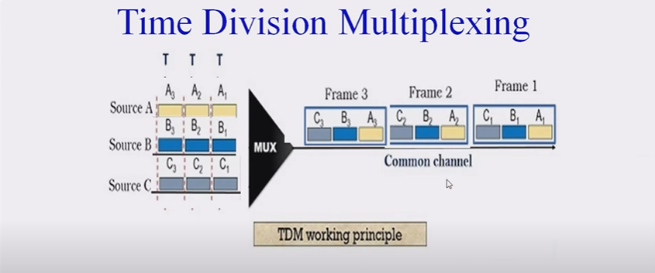

Slide 8
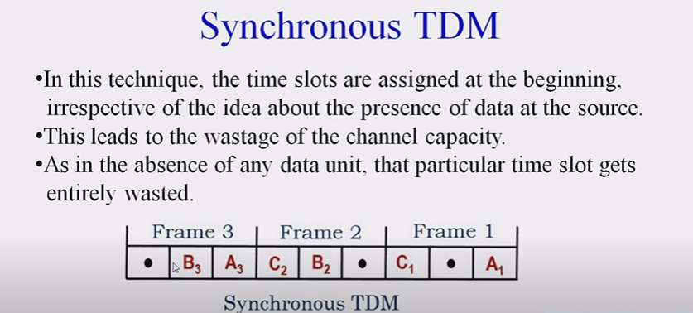

Slide 9
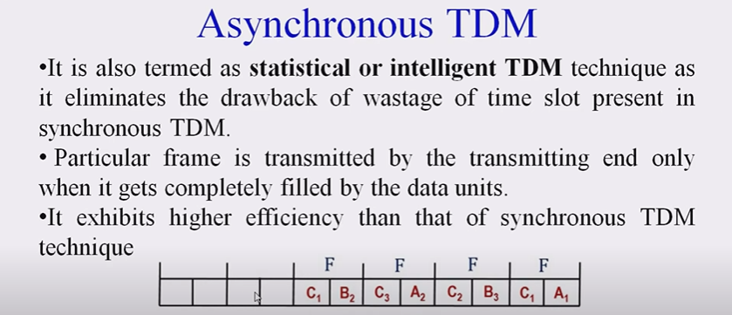

Slide 10
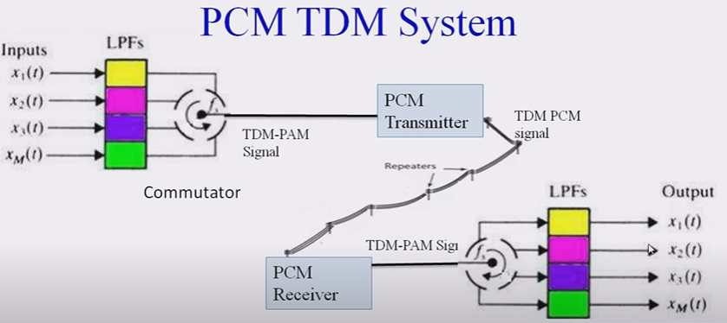

Slide 11
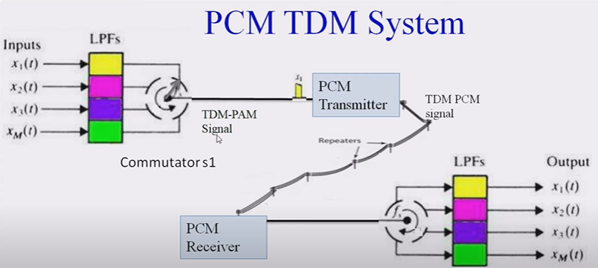

Slide 12
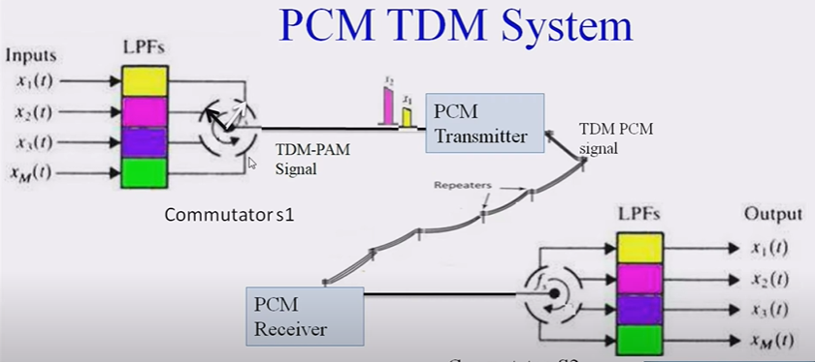

Slide 13
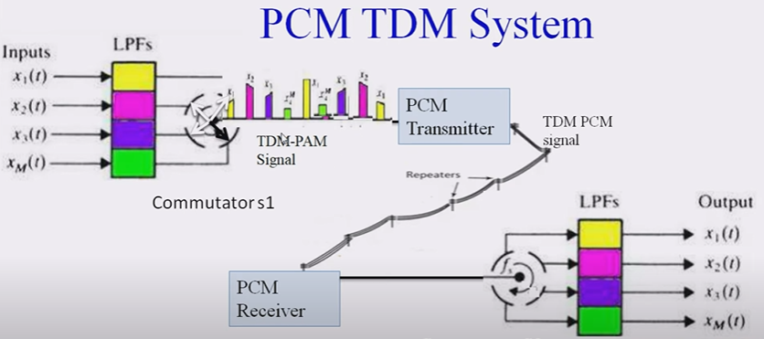

Slide 14
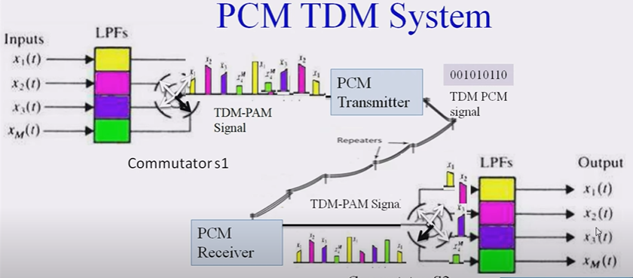

Slide 15
Transmission rate Rb= 1/Tb
Bit duration Tb = Ts /no. of bits in one frame
Frame period Ts= 1/fs
Bits in one frame = m (no. of channel)+1
m = no. of bits in each sample = 8 bits
fs = sampling rate (sampling freq.)= 8 KHz

